Slide 1
Department of Computer Science & Business Systems SUBJECT: Usability Design of Software Applications Subject Code: Topic Name: Project design lifecycle IV year, Sec: A
Vallurupalli Nageswara Rao Vignana Jyothi Institute of Engineering &Technology
Bhagya Rekha Konkepudi
Assistant Professor
Email: bhagyarekha_k@vnrvjiet.in
<Web link of your created resource if any>

Slide 2
Agenda
Project design lifecycle: Redesign project through the design lifecycle
Discovery
Define
Design
Implement (Design Prototype)
Usability Testing

Slide 3
The Process of Interaction Design
The process of interaction design involves four basic activities:
1. Establishing requirements
2. Designing alternatives
3. Prototyping
4. Evaluating.

Slide 4
The Process of Interaction Design
Establishing Requirements
In order to design something to support people, we must know who our target users are and what kind of support an interactive product could usefully provide. These needs form the basis of the product's requirements and underpin subsequent design and development. This activity is fundamental to a user-centered approach and is very important in interaction design.
Designing Alternatives
This is the core activity of designing: actually suggesting ideas for meeting the requirements. This activity can be viewed as two sub-activities:
conceptual design
Conceptual design involves producing the conceptual model for the product, and a conceptual model describes an abstraction outlining what people can do with a product and what concepts are needed to understand how to interact with it.
concrete design
The concrete design considers the detail of the product including the colors, sounds, and images to use menu design, and icon design.

Slide 5
The Process of Interaction Design
Prototyping
Interaction design involves designing interactive products. The most sensible way for users to evaluate such designs is to interact with them, and this can be achieved through prototyping. This does not necessarily mean a piece of software is required. There are different prototyping techniques, not all of which require a working piece of software. For example, paper-based prototypes are very quick and cheap to build and are very effective for identifying problems in the early stages of design, and through role-playing users can get a real sense of what it will be like to interact with the prototype.
Evaluating
Evaluation is the process of determining the usability and acceptability of the product or design that is measured in terms of a variety of usability and user experience criteria. Interaction design requires a high level of user involvement throughout development, and this enhances the chances of an acceptable product being delivered. Evaluation does not replace the activities concerned with quality assurance and testing to make sure that the final product is fit for its purpose, but it complements and enhances the product.

Slide 6
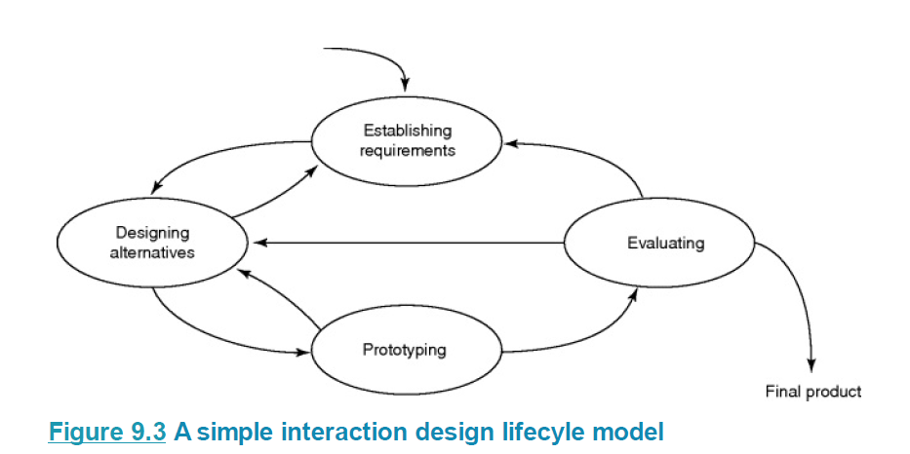
The Process of Interaction Design

Slide 7
What is Requirement ?
A requirement is a statement about an intended product that specifies what it should do or how it should perform.
One of the aims of the requirements activity is to make the requirements as specific, unambiguous, and clear as possible.
For example, a requirement for a smartwatch GPS app might be that the time to load a map is less than half a second.
Another, less precise, an example might be that teenagers should find the smartwatch appealing. In
the case of this latter example, further investigation would be necessary to explore exactly what teenagers would find appealing.
Requirements come in many different forms and at many different levels of abstraction, but we need to make sure that the requirements are as clear as possible and that we understand how to tell when they have been fulfilled.

Slide 8
What is Requirement ?
Interaction design involves understanding the functionality required and the constraints under which the product must operate or be developed, hence we are concerned with a wide range of requirements.
Functional requirements
Data requirements
Environmental requirements

Slide 9
What is Requirement ?
Functional requirements capture what the product should do. For example, a functional requirement for a robot working in a car assembly plant might be that it should be able to accurately place and weld together the correct pieces of metal. Understanding the functional requirements for an interactive product is fundamental.
Data requirements capture the type, volatility, size/amount, persistence, accuracy, and value of the required data. All interactive products have to handle some data. For example, if the system under consideration is a share-dealing application, then the data must be up-to-date and accurate and is likely to change many times a day. In the personal banking domain, data must be accurate, must persist over many months and probably years, and there is likely to be a lot of it.

Slide 10
What is Requirement ?
Environmental requirements refer to the circumstances in which the interactive product will operate.
Four aspects of the environment must be considered when establishing requirements.
First is the physical environment, such as how much lighting, noise, movement, and dust is expected in the operational environment. Will users need to wear protective clothing, such as large gloves or headgear that might affect the choice of an interface type? How crowded is the environment?
For example, an ATM operates in a very public physical environment – using a speech interface is therefore likely to be problematic.
The second aspect of the environment is the social environment.
For example, will data need to be shared? If so, does the sharing have to be synchronous (e.g. does everyone need to be viewing the data at once?) or asynchronous (e.g. two people authoring a report take turns in editing it)? Do other factors include the physical location of fellow team members, e.g. do collaborators need to communicate across great distances?
The third aspect is the organizational environment, e.g. how good is user support likely to be, how easily can it be obtained, and are there facilities or resources for training? How efficient or stable is the communications infrastructure? And so on.
Finally, the technical environment will need to be established: for example, what technologies will the product run on or need to be compatible with, and what technological limitations might be relevant?

Slide 11
How do you go about identifying requirements?
Requirements discovery is highly proactive, interactive, and, well, sometimes hyperactive! You are engaged in eliciting, analyzing, specifying, prototyping, and testing. And in the best practices we've been involved in, you are constantly discovering (a.k.a. identifying) product needs. It's not a ‘one-and-done’ activity.
Elicitation includes interviews, existing documentation study, exploratory prototypes, facilitated workshops, focus groups, observation (including apprenticing, contextual inquiry, and ethnography), surveys (and other research-based techniques), and user task analysis (including storyboarding and scenario analysis). There are a number of specific techniques within each of these general categories, and some techniques overlap.
Analyzing involves using lightweight models, often combined with specifications, which are often in the form of acceptance tests or prototypes, or both.
It's not enough to get the right people together and ask the right questions. To communicate efficiently and effectively about how to deliver, product partners need a focused way to communicate and make decisions together.

Slide 12
How do you go about identifying requirements?
the most efficient and effective discovery mechanism is a collaborative approach called the ‘structured conversation.’ In a structured conversation, the product partners first explore possible requirements (options) for their next increment. They do this within and across the 7 Product Dimensions. This enables product partners to collaboratively and creatively explore a range of possibilities. This expansive thinking opens up product innovation, experimentation, and mutual learning.
They then evaluate these many options in terms of value. This means having a shared understanding of what value really means at that point in time. Once they have narrowed the list of options through the evaluation process, they confirm how they will verify and validate these candidate solutions with unambiguous acceptance criteria. The validation includes how to test that they delivered the right requirements and that they achieved the anticipated value from each delivery.

Slide 13
Establishing Requirements
Data gathering is a central part of establishing requirements, and of evaluation. Within the requirements activity, the purpose of data gathering is to collect sufficient, accurate, and relevant data so that a set of stable requirements can be produced; within the evaluation, data gathering is needed to capture users’ reactions and performance with a system or prototype.
There are three main techniques for gathering data:
Interviews involve an interviewer asking one or more interviewees a set of questions, which may be highly structured or unstructured; interviews are usually synchronous and are often face-to-face, but they don't have to be.
Questionnaires are a series of questions designed to be answered asynchronously, i.e. without the presence of the investigator; these may be on paper, or online.
Observation may be direct or indirect. Direct observation involves spending time with individuals observing activity as it happens. Indirect observation involves making a record of the user's activity as it happens to be studied at a later date. All three techniques may be used to collect qualitative or quantitative data.
Interviews
Observation
Questionnaires

Slide 14
Establishing Requirements – Data gathering
Data gathering sessions need to be planned and carried out carefully. we consider five key issues that require
attention for any data gathering session to be successful:
goal setting,
identifying participants,
the relationship between the data collector and the data provider,
triangulation, and
pilot studies.

Slide 15
Establishing Requirements – Data gathering
Setting Goals
The main reason for gathering data at all is to collect information about something.
Examples:
We might want to understand how technology fits into normal family life,
We might want to identify which of the two icons representing ‘send message’ is easier to use,
We might want to find out whether the redesign you are planning for a hand-held meter reader is along the right lines.
There are many different reasons for gathering data, and before beginning, it is important to identify specific goals for the study. The goals that are set will influence the nature of the data gathering sessions, the data gathering techniques to be used, and the analysis to be performed. Once the goals have been set, you can concentrate on what data to look for and what to do with it once it is gathered.
The goals may be expressed formally, e.g. using some structured or even mathematical format, or using a
simple description such as the ones in the previous paragraph, but whatever the format they should be
clear and concise. In interaction design, it is more usual to express goals for data gathering informally.

Slide 16
Establishing Requirements – Data gathering
Identifying Participants
The goals you develop for your data gathering session will indicate the kind of people you want to gather data from. Those people who fit this profile are called the population.
In some cases, the people you need to gather data from may be clearly identifiable – maybe because there is a small group of users, and you have access to each one. However, it is more likely that you will need to choose the participants to include in your data gathering, and this is called sampling.
The situation where you have access to all members of your target population is called saturation sampling, but this is quite rare. Assuming that you will be choosing to involve a proportion of your population in data gathering, then you have two options:
probability sampling
nonprobability sampling.

Slide 17
Establishing Requirements – Data gathering
Probability Sampling
the most used approaches are simple random sampling or stratified sampling.
Random sampling can be achieved by using a random number generator or by choosing every nth person in a list.
Stratified sampling relies on being able to divide the population into groups (e.g. classes in a secondary school), and then applying random sampling.
Non- Probability Sampling
The most common approaches used here are convenience sampling or volunteer panels. Both these approaches rely less on you choosing the participants and more on participants being prepared to take part. The term convenience sampling is used to describe a situation where the sample includes those who were available rather than those specifically selected.
The crucial difference between probability and non-probability methods is that in the former you can apply statistical tests and generalize to the whole population, while in the latter such generalizations are not robust. Using statistics also requires having a sufficient number of participants. What exactly ‘sufficient’ means will depend on the type of data being collected and the kind of statistical tests that need to be applied.

Slide 18
Establishing Requirements – Data gathering
Relationship with Participants
One significant aspect of any data gathering is the relationship between the person (people) doing the gathering and the person (people) providing the data.
Making sure that this relationship is clear and professional will help to clarify the nature of the study. One way in which this can be achieved is to ask participants to sign an informed consent form.
The details of this form will vary, but it usually asks the participants to confirm that the purpose of the data gathering and how the data will be used have been explained to them and that they are happy to continue.
It also often includes a statement that participants may withdraw at any time, and that in this case none of their data will be used in the study.

Slide 19
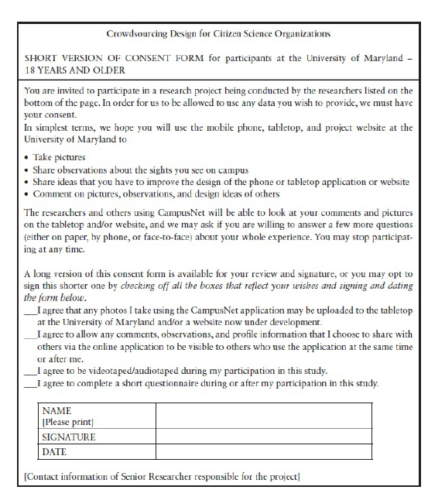
Establishing Requirements – Data gathering
Relationship with Participants
The informed consent form is intended to protect the interests of both the data gatherer and the data provider.
The gatherer wants to know that the data she collects can be used in her analysis, presented to interested parties, and published in reports (as appropriate).
The data provider wants reassurance that the information he gives will not be used for other purposes, or in any context that would be detrimental to him.
For example, he wants to be sure that personal contact information and other personal details are not made public. This is especially true when people with disabilities or children are being interviewed.
In the case of children, using an informed consent form reassures parents that their children will not be asked threatening, inappropriate, or embarrassing questions, or be asked to look at disturbing or violent images.

Slide 20
Establishing Requirements – Data gathering
Relationship with Participants
However, this kind of consent is not generally required when collecting data for the requirements activity where a contract usually exists in some form between the data collector and the data provider.
For example, consider the situation where a consultant is hired to gather data from a company in order to establish a set of requirements for a new interactive system to support timesheet entry. The employees of this company would be the users of the system, and the consultant would therefore expect to have access to the employees to gather data about the timesheet activity. In addition, the company would expect its employees to cooperate in this exercise. In this case, there is already a contract in place which covers the data gathering activity, and therefore an informed consent form is less likely to be required.

Slide 21
Establishing Requirements – Data gathering
Triangulation
Triangulation is a term used to refer to the investigation of a phenomenon from (at least) two different perspectives (Denzin, 2006; Jupp, 2006). Four types of triangulation have been defined (Jupp, 2006):
Triangulation of data means that data is drawn from different sources at different times, in different places, or from different people (possibly by using a different sampling technique).
Investigator triangulation means that different researchers (observers, interviewers, etc.) have been used to collect and interpret the data.
Triangulation of theories means the use of different theoretical frameworks through which to view the data or findings.
Methodological triangulation means employing different data gathering techniques.
The last of these is the most common form of triangulation.

Slide 22
Establishing Requirements – Data gathering
Triangulation
One application of triangulation (and again the most common) is to validate the results of some inquiry by pointing to similar results yielded through the use of different perspectives. However, validation through triangulation is difficult to achieve.
Different data gathering methods result in different kinds of data, which may or may not be compatible. Using different theoretical frameworks may or may not result in complementary findings, but achieving theoretical triangulation would require the theories to have similar philosophical underpinnings. Using more than one data gathering technique, and more than one data.

Slide 23
Establishing Requirements – Data gathering
Pilot Studies
A pilot study is a small trial run of the main study.
The aim is to make sure that the proposed method is viable before embarking on the real study.
Data gathering participants can be (and usually are) very unpredictable, even when a lot of time and effort has been spent carefully planning the data gathering session. Plans should be tested by doing a pilot study before launching into the main study.
For example, the equipment and instructions that are to be used can be checked, the questions for an interview or in a questionnaire can be tested for clarity, and an experimental procedure can be confirmed as viable. Potential problems can be identified in advance so that they can be corrected.
Distributing 500 questionnaires and then being told that two of the questions were very confusing wastes time, annoys participants, and is an expensive error that could have been avoided by doing a pilot study.
If it is difficult to find people to participate or if access to participants is limited, colleagues or peers can be asked to comment. Getting comments from peers is quick and inexpensive and can be a substitute for a pilot study.
It is important to note that anyone involved in a pilot study cannot be involved in the main study. Why? Because they will know more about the study and this can distort the results.

Slide 24
How do you know when you have collected enough requirements to go on to the next step?
A ‘right requirement’ can be characterized as one that is:
Just in time, just enough. It is essential for achieving the business objectives, in this time period.
Realistic. It is capable of being delivered with the available resources.
Clearly and unambiguously defined. Acceptance criteria exist that all partners understand and will use to verify and validate the product.
Valuable. It is indispensable

Slide 25
DATA ANALYSIS, INTERPRETATION, AND PRESENTATION

Slide 26
DATA ANALYSIS, INTERPRETATION, AND PRESENTATION
Methods and approaches for analysis, interpretation, and presentation of data are applicable during the requirements activity to structure and record descriptions of requirements.
Some kinds of requirements are best investigated using more formal techniques and notations. For example, functional requirements may be analyzed and documented using class diagrams, state charts, and sequence diagrams, among others. Data requirements can be expressed using entity relationship diagrams, and so on.

Slide 27
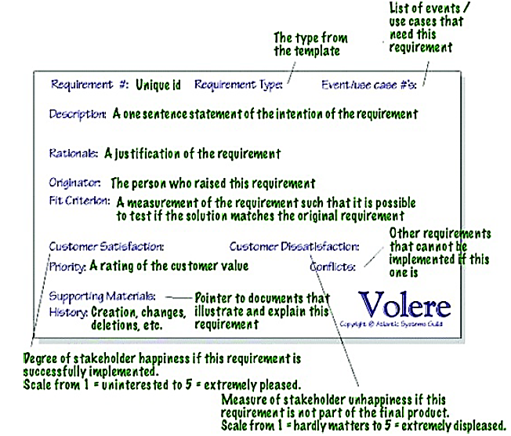
DATA ANALYSIS, INTERPRETATION, AND PRESENTATION

Slide 28
DATA ANALYSIS, INTERPRETATION, AND PRESENTATION
Qualitative
Relates to the characteristics or features of something, rather than its quantity. Qualitative data is descriptive and interpretation-based, and is often collected through interviews, observations, and focus groups. Qualitative research is often used to understand the "why" behind a phenomenon, and to explore the "how" and "why" of human behavior.
Quantitative
Relates to or is expressible in terms of quantity. Quantitative data is numbers-based, countable, or measurable, and is often collected through surveys, experiments, and statistical models. Quantitative research is often used to answer the "what" or "how" of a phenomenon, and to analyze statistical relationships.

Slide 29
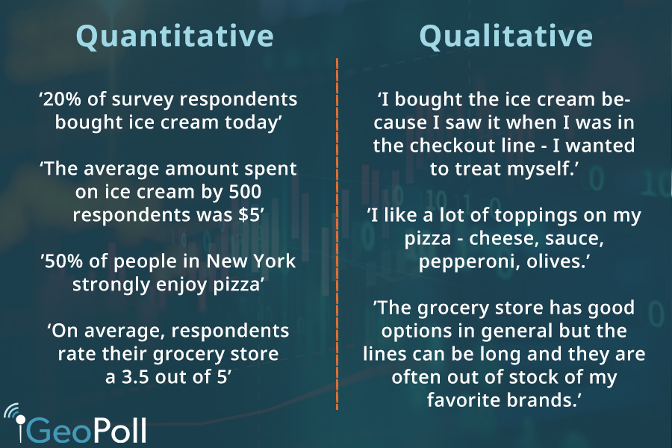
DATA ANALYSIS, INTERPRETATION, AND PRESENTATION
The kind of analysis that can be performed on a set of data will be influenced by the goals identified at the outset, and the data gathered. Broadly speaking, you may take a qualitative analysis approach or a quantitative analysis approach, or a combination of qualitative and quantitative.

Slide 30
DATA ANALYSIS, INTERPRETATION, AND PRESENTATION
Quantitative data is data that is in the form of numbers, or that can easily be translated into numbers.
For example, the number of years of experience the interviewees have, the number of projects a department handles at a time, or the number of minutes it takes to perform a task.
Qualitative data is not expressed in numerical terms.
For example, qualitative data includes descriptions, quotes from interviewees, vignettes of activity, and images. It is possible to express qualitative data in numerical form, but it is not always meant to do so.
It is sometimes assumed that certain forms of data gathering can only result in quantitative data and others can only result in qualitative data. However, this is a fallacy.
For example, on a questionnaire, questions about the participant's age or the number of software packages they use a day will result in quantitative data, while any comment fields will result in qualitative data.
In an observation, quantitative data you may record includes the number of people involved in a project, or how many hours a participant spends trying to sort out a problem they encounter, while notes about the feelings of frustration, or the nature of interactions between team members, are qualitative data.

Slide 31
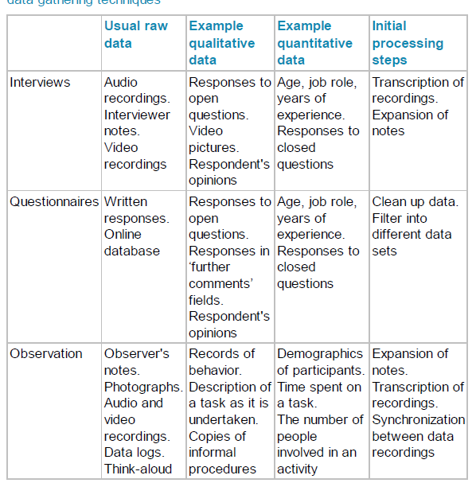
DATA ANALYSIS, INTERPRETATION, AND PRESENTATION
The First Steps in Analyzing Data
Having performed data gathering sessions, there is some initial processing of the data normally required before data analysis can begin in earnest. There are many different combinations of data, but here we discuss typical data collected through interviews, questionnaires, and observation sessions.
Data gathered and typical initial processing steps for the main data gathering techniques

Slide 32
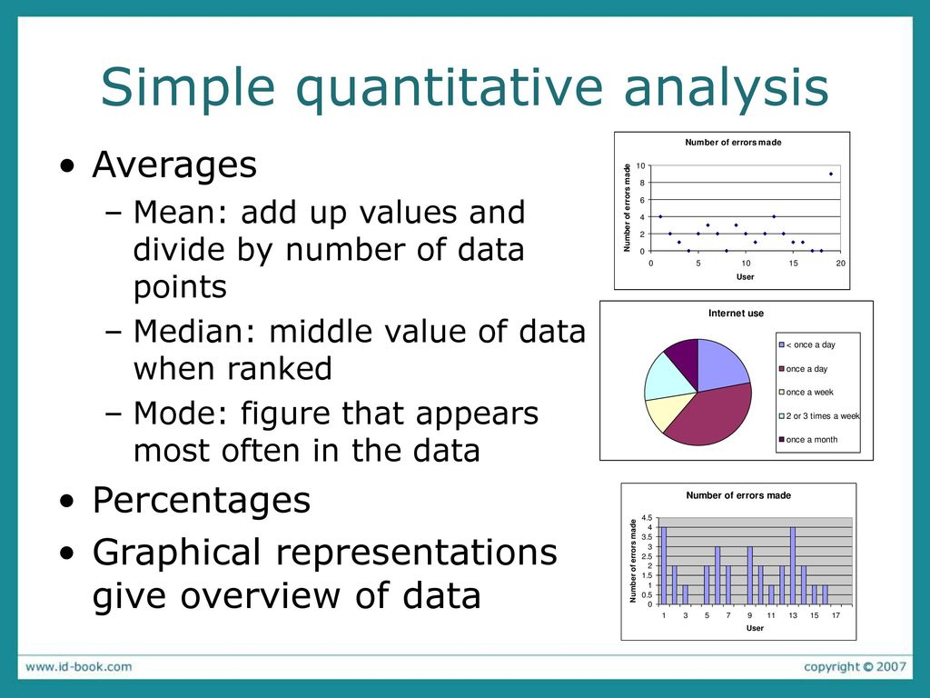
DATA ANALYSIS, INTERPRETATION, AND PRESENTATION
The First Steps in Analyzing Data - Simple Quantitative Analysis
Explaining statistical analysis requires a whole book on its own. We will not try to explain statistics in any detail, although some basic statistical terms. Here, we introduce some simple quantitative analysis techniques you can use effectively in an interaction design context.
The techniques explored here are averages and percentages. Percentages are useful for standardizing the data, particularly if you want to compare two or more large sets of responses.
Averages and percentages are well-known numerical measures. However, there are three different types of average and which one you use changes the meaning of your results. These three are: mean, median, and mode.
Mean refers to the commonly understood interpretation of average: i.e. add together all the figures and divide by the number of figures you started with.
Median and mode are less well-known but are very useful. The median is the middle value of the data when the numbers are ranked.
The mode is the most commonly occurring number.
For example, in a set of data (2, 3, 4, 6, 6, 7, 7, 7, 8), the median is 6 and the mode is 7, while the mean is 50/9 = 5.56. In this case, the difference between the different averages is not that great. However, consider the set (2, 2, 2, 2, 450). Now the median is 2, the mode is 2, and the mean is 458/5 = 91.6!

Slide 33
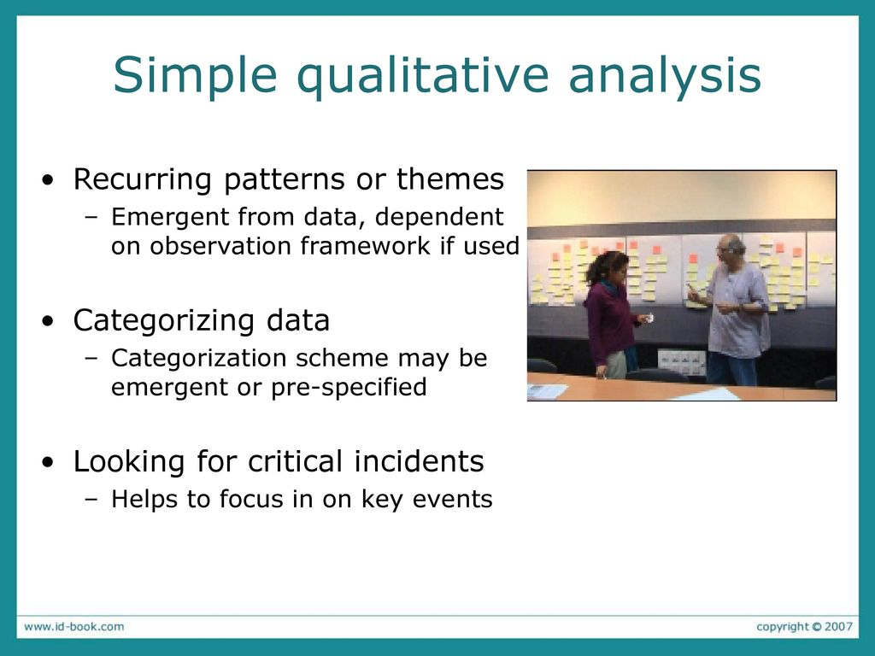
DATA ANALYSIS, INTERPRETATION, AND PRESENTATION
The First Steps in Analyzing Data - Simple Qualitative Analysis
As with quantitative analysis, the first step in qualitative analysis is to gain an overall impression of the data and to start looking for patterns. Some patterns will have emerged during the data gathering itself, and so you may already have some idea of the kinds of patterns to look for, but it is important to confirm and re-confirm findings to make sure that initial impressions are not biasing analysis.
For observation data, the guiding framework will have given some structure to the data. For example, the practitioner's framework will have resulted in a focus on who, where, and what, while using Robson's more detailed framework will result in patterns relating to physical objects, people's goals, sequences of events, and so on.
There are three simple types of qualitative analysis that we discuss here: identifying recurring patterns and themes, categorizing data, and analyzing critical incidents.

Slide 34
DATA ANALYSIS, INTERPRETATION, AND PRESENTATION
Identifying Recurring Patterns or Themes
There are different techniques for identifying themes in qualitative data (e.g. Braun and Clarke, 2006). The affinity diagram, which is used in contextual design (Beyer and Holtzblatt, 1998; Holtzblatt, 2001) is one common technique used in qualitative analysis.
It aims to organize individual ideas and insights into a hierarchy showing common structures and themes. Notes are grouped together because they are similar in some fashion. The groups are not predefined but emerge from the data.
The process was originally introduced into the software quality community from Japan, where it is regarded as one of the seven quality processes.
The affinity diagram is built by a process of induction. One note is put up first, and then the team searches for other notes that are related in some way.
For example, De Angeli et al (2004) collected data through field observations and semi-structured interviews to investigate the use of ATMs (automated teller machines) in Mumbai, India. As part of their data analysis, they used affinity diagrams to cluster issues into themes

Slide 35
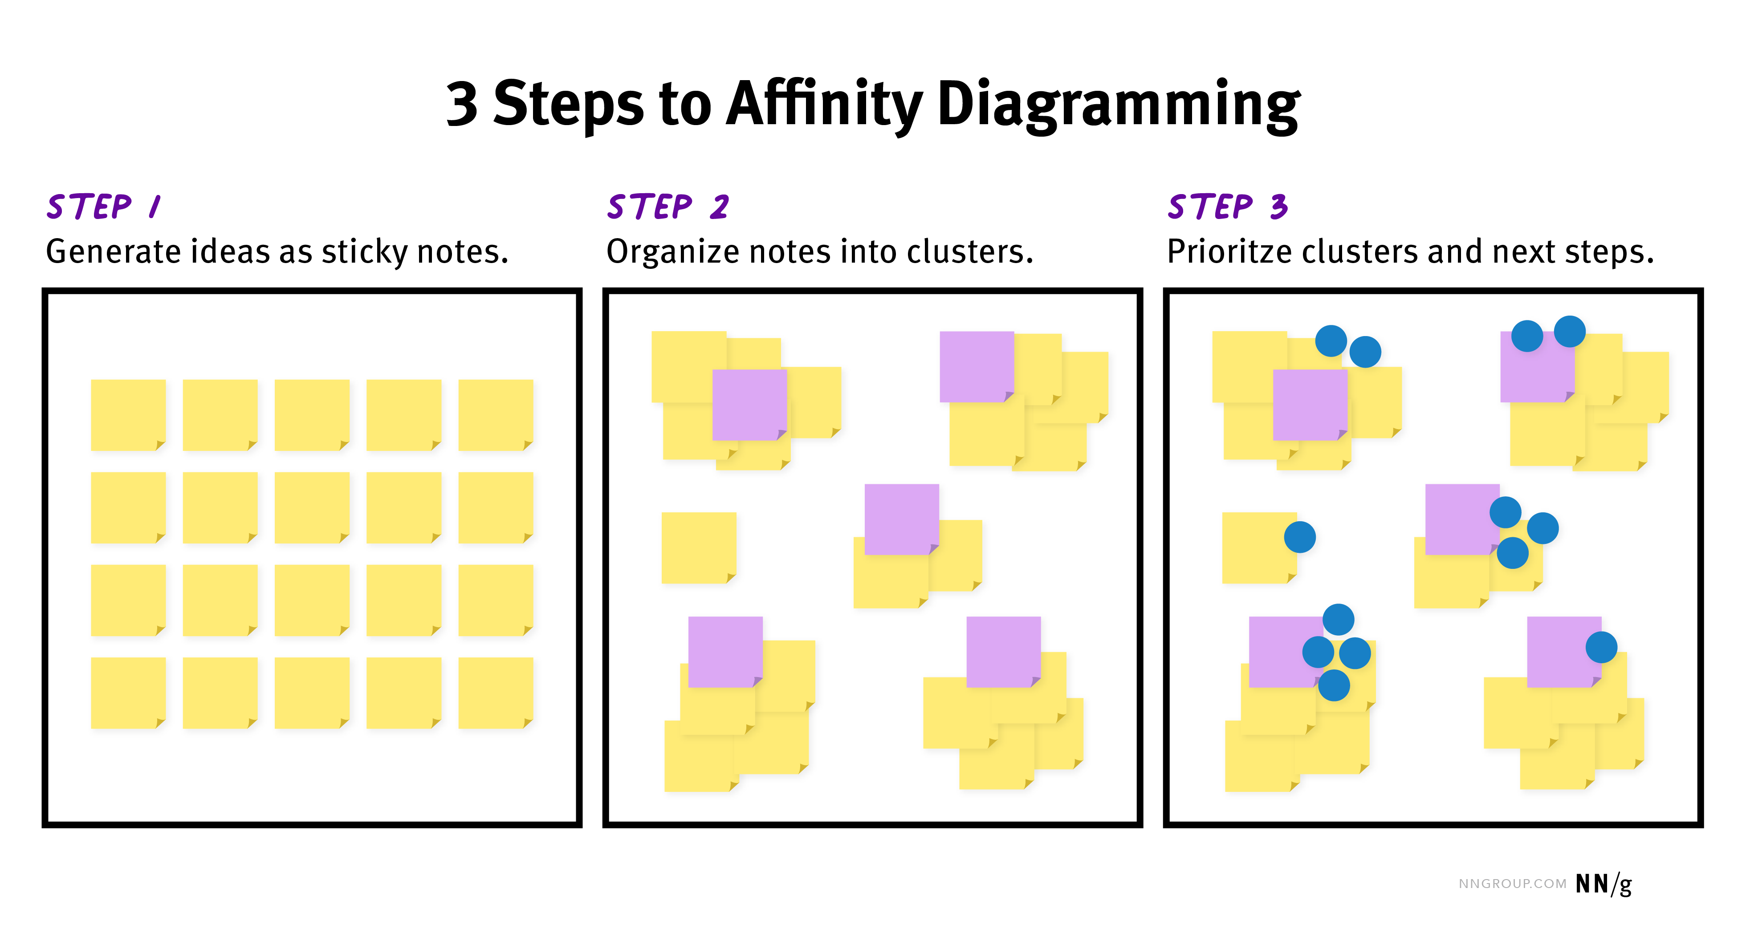
DATA ANALYSIS, INTERPRETATION, AND PRESENTATION

Slide 36
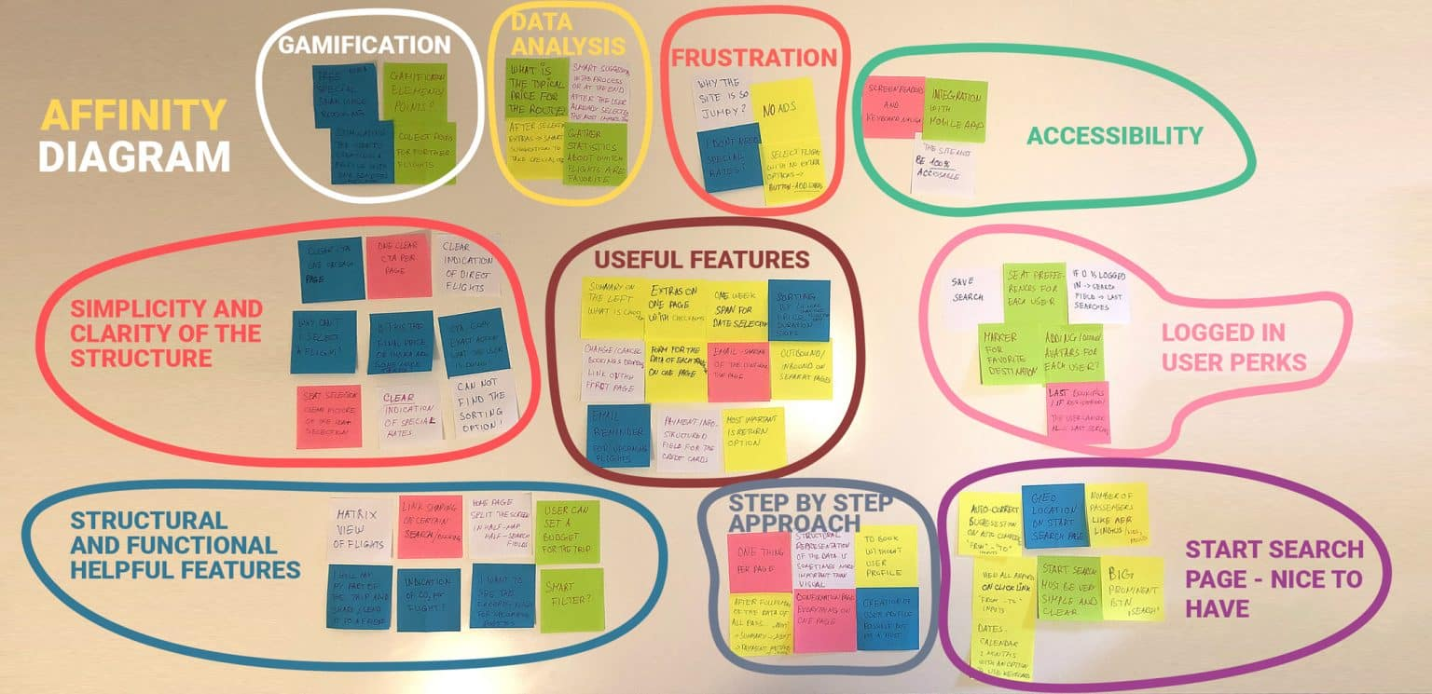
DATA ANALYSIS, INTERPRETATION, AND PRESENTATION
Identifying Recurring Patterns or Themes

Slide 37
DATA ANALYSIS, INTERPRETATION, AND PRESENTATION
Categorizing Data
Transcripts of meetings, interviews, or think-aloud protocols can be analyzed at a high level of detail, such as identifying stories or themes, or at a fine level of detail in which each word, phrase, utterance, or gesture is analyzed.
Either way, elements identified in the data are usually categorized first using a categorization scheme. The categorization scheme may arise from the data itself, if the investigation is exploratory, as it might be in the requirements activity, or it might originate elsewhere in a well-recognized categorization scheme, or a combination of these two approaches may be used.
The principle here is that the data is divided up into elements and each element is then categorized. Which categories to use is largely determined by the goal of the study. One of the most challenging aspects is determining meaningful categories that are
orthogonal (i.e. do not overlap). Another is deciding on the appropriate
granularity for the categories (e.g. at word, phrase, sentence, or paragraph level); this is also dependent on the goal of the study and the data being analyzed.)

Slide 38
DATA ANALYSIS, INTERPRETATION, AND PRESENTATION
Looking for Critical Incidents
Data gathering sessions can often result in a lot of data. Analyzing all of that data in any detail is very time-consuming, and often not necessary. We have already suggested that themes, patterns, and categories can be used to identify areas where detailed analysis is appropriate. Another approach is to use the critical incident technique.
In interaction design, critical incident analysis has been used in a variety of ways, but the main focus is to identify specific incidents that are significant, and then to focus on these and analyze them in detail, using the rest of the data collected as context to inform interpretation. These may be identified by the users during a retrospective discussion of a recent event, or by an observer either through studying video footage or in real-time.
For example, in an evaluation study, a critical incident may be signaled by times when users were obviously stuck – usually marked by a comment, silence, looks of puzzlement, and so on.

Slide 39
DATA ANALYSIS, INTERPRETATION, AND PRESENTATION
Tools to Support Data Analysis
Tools to support the organization and manipulation of data include facilities for categorization, theme-based analysis, and quantitative analysis. These typically provide facilities to associate labels (categories, themes, and so on) with sections of data, search the data for keywords or phrases, investigate the relationships between different themes or categories, and help to develop the coding scheme further; some tools can also generate graphical representations.
Two well-known tools that support some of these data analysis activities are Nvivo and Atlas.ti. Nvivo, for example, supports the annotation and coding of data including PDF documents, photos, and video and audio files. Using Nvivo, field notes can be searched for keywords or phrases to support coding or content analysis; codes and data can be explored, merged, and manipulated in several ways. The information can also be printed in a variety of forms such as a list of every occasion a word or phrase is used in the data, and a tree structure showing the relationships between codes.

Slide 40
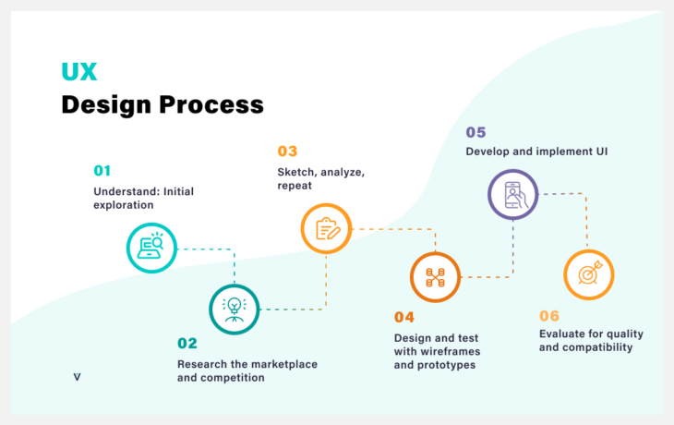

Slide 41
Design
Design activities begin once some requirements have been established. The design emerges iteratively, through repeated design–evaluation–redesign cycles involving users. Broadly speaking, there are two types of design:
Conceptual Design which is concerned with developing a conceptual model that captures what the product will do and how it will behave
Concrete Design is concerned with details of the design such as menu structures, haptic feedback, physical widgets, and graphics.
As design cycles become shorter, the distinction between these two becomes blurred, but they are worth distinguishing because each emphasizes a different set of design concerns.

Slide 42
Conceptual Design
Designing the conceptual model is fundamental to interaction design and is concerned with transforming requirements into a conceptual model.
A conceptual model is an outline of what people can do with a product and what concepts are needed to understand how to interact with it.
Key guiding principles of conceptual design are:
Keep an open mind but never forget the users and their context.
Discuss ideas with other stakeholders as much as possible.
Use prototyping to get rapid feedback.
Iterate, iterate, and iterate.

Slide 43
Steps in Conceptual Design
Conceptual Design
Developing an Initial Conceptual Model
Interface metaphors
Interaction types
Expanding the Initial Conceptual Model
What functions will the product perform?
Interface types.
How are the functions related to each other?
What information is needed?

Slide 44
Developing an Initial Conceptual Model
Some elements of a conceptual model will derive from the requirements for the product. For example, the requirements activity will have provided information about the concepts involved in a task and their relationships, e.g. through task descriptions and analysis.
Immersion in the data and attempting to empathize with the users as described above will, together with the requirements, provide information about the product's user experience goals, and give you a good understanding of what the product should be like.
We need to discuss approaches that help in pulling together an initial conceptual model. In particular, we consider:
Which interface metaphors would be suitable to help users understand the product?
Which interaction type(s) would best support the users’ activities?
Do different interface types suggest alternative design insights or options?

Slide 45
Developing an Initial Conceptual Model
Interface metaphors.
Interface metaphors combine familiar knowledge with new knowledge in a way that will help the user understand the product. Choosing suitable metaphors and combining new and familiar concepts requires a careful balance between utility and fun, and is based on a sound understanding of the users and their context.
For example, consider an educational system to teach 6-year-olds mathematics. One possible metaphor is a classroom with a teacher standing on the blackboard. But if you consider the users of the system and what is likely to engage them, a metaphor that reminds the children of something they enjoy would be more suitable, such as a ball game, the circus, a playroom, and so on.

Slide 46
Developing an Initial Conceptual Model
Interface metaphors.
Erickson (1990) suggests a three-step process for choosing a good interface metaphor.
The first step is to understand what the system will do, i.e. identifying the functional requirements. Developing partial conceptual models and trying them out may be part of the process.
The second step is to understand which bits of the product are likely to cause users problems, i.e. which tasks or subtasks cause problems, are complicated, or are critical. A metaphor is only a partial mapping between the software and the real thing upon which the metaphor is based. Understanding areas in which users are likely to have difficulties mean that the metaphor can be chosen to support those aspects.
The third step is to generate metaphors. Looking for metaphors in the users’ descriptions of the tasks is a good starting point. Also, any metaphors used in the application domain with which the users may be familiar may be suitable.

Slide 47
Developing an Initial Conceptual Model
Interface metaphors – Example
For the shared travel organizer, one metaphor we could use is a printed travel brochure, which is commonly found in travel agents. This familiarity could be combined with facilities suitable for an electronic brochure such as videos of locations and searching. To evaluate this metaphor, apply the five questions listed below.
Does it supply structure? Yes, it supplies structure based on the familiar paper-based brochure. This is a book and therefore has pages, a cover, some kind of binding to hold the pages together, an index, and a table of contents. Travel brochures are often structured around destinations but are also sometimes structured around activities, particularly when the company specializes in adventure trips. However, a traditional brochure focuses on the details of the vacation and accommodation and has little structure to support visa or vaccination information (both of which change regularly and are therefore not suitable to include in a printed document).
How much of the metaphor is relevant? Having details of the accommodation, facilities available, a map of the area, and supporting illustrations is relevant for the travel organizer, so the content of the brochure is relevant. Also, structuring that information around types of vacation and destinations is relevant, and preferably both sets of grouping could be offered. But the physical nature of the brochure, such as page-turning, is less relevant. The travel organizer can be more flexible than the brochure and should not try to emulate its book nature. Finally, the brochure is printed maybe once a year and cannot be kept up to date with the latest changes whereas the travel organizer should be capable of offering the most recent information.

Slide 48
Developing an Initial Conceptual Model
Interface metaphors – Example
3. Is the metaphor easy to represent? Yes. The vacation information could be a set of brochure-like pages. Note that this is not the same as saying that the navigation through the pages will be limited to page-turning.
4. Will your audience understand the metaphor? Yes.
5. How extensible is the metaphor? The functionality of a paper-based brochure is fairly limited. However, it is also a book, and we could borrow facilities from ebooks (which are also familiar objects to most of our audience), so yes, it can be extended.

Slide 49
Developing an Initial Conceptual Model
Interaction types
There are four different types of interaction:
instructing,
conversing,
manipulating, and
exploring.
Which is best suited to the current design depends on the application domain and the kind of product being developed.
For example, a computer game is most likely to suit a manipulating style, while a drawing package has aspects of instructing and conversing.

Slide 50
Developing an Initial Conceptual Model
Interaction types – Example
Most conceptual models will include a combination of interaction types, and it is necessary to associate different parts of the interaction with different types.
For example, in the travel organizer, one of the user tasks is to find out the visa regulations for a particular destination. This will require an instructing approach to interaction as no dialog is necessary for the system to show the regulations.
The user simply has to enter a predefined set of information, e.g. country issuing the passport and destination. On the other hand, trying to identify a vacation for a group of people may be conducted more like a conversation.
For example, the user may begin by selecting some characteristics of the destination and some time constraints and preferences, then the organizer will respond with several options, and the user will provide more information or preferences and so on.
Alternatively, users who don't have any clear requirements yet, might prefer to explore availability before asking for specific options.

Slide 51
Developing an Initial Conceptual Model
Interface types.
Considering different interfaces at this stage may seem premature, but it has both a design and a practical purpose. When thinking about the conceptual model for a product, it is important not to be unduly influenced by a predetermined interface type.
Different interface types prompt and support different perspectives on the product under development and suggest different possible behaviors. Therefore considering the effect of different interfaces on the product at this stage is one way to prompt alternatives.
Before the product can be prototyped, some candidate alternative interfaces will need to have been chosen. These decisions will depend on the product constraints, arising from the requirements you have established.
For example, input and output devices will be influenced particularly by the user and environmental requirements. Therefore, considering interfaces here also takes one step toward producing practical prototypes.

Slide 52
Developing an Initial Conceptual Model
Interface types – Example
To illustrate this, we consider a subset of the interfaces and the different perspectives they bring to the travel organizer:
Shareable interface. The travel organizer has to be shareable as it is intended to be used by a group of people, and it should be exciting and fun. For example how best (whether) to use the individuals’ own devices such as smartphones in conjunction with a shared interface.
Tangible interface. Tangible interfaces are a form of sensor-based interaction, where blocks or other physical objects are moved around. Thinking about a travel organizer in this way conjures up an interesting image of people collaborating, maybe with the physical objects representing themselves traveling, but there are practical problems with having this kind of interface, as the objects may be lost or damaged.
Augmented and mixed reality. The travel organizer is not the kind of product that is usually designed for an augmented or mixed reality interface. The question is what would the physical object be in this case, that the virtual element could enhance? One possibility might be to enhance the physical brochure to provide more dynamic and easily changed information.

Slide 53
Expanding the Initial Conceptual Model
Considering the issues in the previous section helps the designer to produce a set of initial conceptual model ideas. These ideas must be thought through in more detail and expanded before being prototyped or tested with users.
For example, concrete suggestions of the concepts to be communicated between the user and the product and how they are to be structured, related, and presented are needed. This means deciding which functions the product will perform (and which the user will perform), how those functions are related, and what information is required to support them. These decisions will be made initially only tentatively and may change after prototyping and evaluation.

Slide 54
Expanding the Initial Conceptual Model
Expanding the Initial Conceptual Model - What functions will the product perform?
Understanding the tasks the product will support is a fundamental aspect of developing the conceptual model, but it is also important to consider which elements of the task will be the responsibility of the user and which will be carried out by the product.
For example, the travel organizer may suggest specific vacation options for a given set of people, but is that as much as it should do? Should it automatically reserve the booking, or wait until it is told that this travel arrangement is suitable? Developing scenarios, essential use cases, and use cases will help clarify the answers to these questions.
Deciding what the system will do and what the user will do is sometimes called task allocation. And is linked to social aspects of collaboration. If the cognitive load is too high for the user, then the device may be too stressful to use. On the other hand, if the product has too much control and is too inflexible, then it may not be used at all.
Another decision is which functions to hard-wire into the product and which to leave under software control, and thereby indirectly in the control of the human user.

Slide 55
Expanding the Initial Conceptual Model
Expanding the Initial Conceptual Model - How are the functions related to each other?
Functions may be related temporally, e.g. one must be performed before another, or two can be performed in parallel. They may also be related through any number of possible categorizations.
Example :
all functions relating to privacy on a smartphone, or
all options for viewing photographs in a social networking site.
The relationships between tasks may constrain use or may indicate suitable task structures within the product. For example, if one task depends on another, the order in which tasks can be completed may need to be restricted.
If task analysis has been performed, the breakdown will support these kinds of decisions. For example, in the travel organizer example, there are subtasks involved and the order in which the subtasks can be performed. Thus, the system could allow potential travel companies to be found before or after investigating the destination’s facilities. It is, however, important to identify the potential travel companies before looking for availability.

Slide 56
Expanding the Initial Conceptual Model
Expanding the Initial Conceptual Model - What information is needed?
What data is required to perform a task? How is this data to be transformed by the system? Data is one of the categories of requirements identified and captured through the requirements activity.
During conceptual design, these requirements are considered to ensure that the model provides the information necessary to perform the task. Detailed issues of structure and display, such as whether to use an analog display or a digital display, will more likely be dealt with during the concrete design activity, but implications arising from the type of data to be displayed may impact conceptual design issues.
For example, identifying potential vacations for a set of people using the travel organizer requires the following information:
what kind of vacation is required;
available budget;
preferred destinations (if any);
preferred dates
and duration (if any);
how many people it is for; and
any special requirements (such as disability) that this group has.
In order to perform the function, the system needs this information and must have access to detailed vacation and destination descriptions, booking availability, facilities, restrictions, and so on.
Initial conceptual models may be captured in wireframes – a set of documents that show structure, content, and controls. Wireframes may be constructed at varying levels of abstraction and may show a part of the product or a complete overview.

Slide 57
Concrete Design

Slide 58
Concrete Design
Conceptual design and concrete design are closely related. The difference between them is rather a matter of changing emphasis: during design, conceptual issues will sometimes be highlighted and at other times, concrete detail will be stressed. Producing a prototype inevitably means making some concrete decisions, albeit tentatively, and since interaction design is iterative, some detailed issues will come up during conceptual design, and vice versa.
There are many aspects to the concrete design of interactive products: visual appearance such as color and graphics, icon design, button design, interface layout, choice of interaction devices, and so on.
Concrete design also deals with issues related to user characteristics and context, and two aspects that have drawn particular attention for concrete design are
Accessibility means where Researchers, designers, and evaluators have investigated a range of techniques, toolkits, and interaction devices to support individuals with different accessibility needs. More recently, there has been a reaction to this approach that challenges the ‘rhetoric of compassion in favor of a ‘rhetoric of engagement', and suggests that users be empowered rather than designed for (Rogers and Marsden, 2013).
National culture include the use of appropriate language(s), colors, icons and images, navigation, and information architecture.

Slide 59
Implement (Design Prototype)

Slide 60
Implement (Design Prototype)
For users to evaluate the design of an interactive product effectively, designers must prototype their ideas. In the early stages of development, these prototypes may be made of paper and cardboard, or ready-made components pulled together to allow evaluation, while as the design progresses, they become more polished, compact, and robust so that they resemble the final product.
A prototype is one manifestation of a design that allows stakeholders to interact with it and to explore its suitability; it is limited in that a prototype will usually emphasize one set of product characteristics and de-emphasize others.
prototype can also be a paper-based outline of a display, a collection of wires and ready-made components, an electronic picture, a video simulation, a complex piece of software and hardware, or a three dimensional mockup of a workstation.

Slide 61
Implement (Design Prototype)
Prototypes are useful when discussing or evaluating ideas with stakeholders; they are a communication device among team members and an effective way for designers to explore design ideas. The activity of building prototypes encourages reflection in design, as described by Schön (1983), and is recognized by designers from many disciplines as an important aspect of design.
Prototypes answer questions and support designers in choosing between alternatives. Hence, they serve a variety of purposes:
To test out the technical feasibility of an idea,
To clarify some vague requirements,
To do some user testing and evaluation, or
To check that a certain design direction is compatible with the rest of the product development.
The purpose of your prototype will influence the kind of prototype you build. So, for example, if you want to clarify how users might perform a set of tasks

Slide 62
Implement (Design Prototype)
Prototyping
Low-Fidelity Prototyping
Storyboarding
Sketching
High-Fidelity Prototyping
Prototyping with index cards
Wizard of Oz.

Slide 63
Implement (Design Prototype)
How to Start the Prototyping Process
After receiving a 50-page requirements document from a client, looking at a blank canvas can be daunting. Reviewing unorganized thoughts from client meetings, napkin sketches, and dirty whiteboard photos rarely help.
Because prototypes are built on so much other information, it’s important to gather the necessary details in advance to putting pen to paper. Consider the following checklist and review the details provided by your client or manager:

Slide 64
Implement (Design Prototype) – STEPS
1. What are the goals of the project?
Start with the big picture. Does the product solve a real need? How does it solve that need? Understanding the product’s utility is critical to delivering any sort of viable solution.
2. What competitive products do people currently use?
A strong competitive analysis will provide a clear picture of the state of the marketplace for the product type, plus what today’s users expect.
3. Who is the audience? What are their goals?
Understanding demographics and user needs provide the context necessary to create products geared toward providing for those particular user types and fulfilling their needs.
4. What type of product is it, and what (device) is it for?
With so many different technologies and solutions, UX designers need to know how the product will be used (web app, responsive website, mobile app, etc.), on what device(s), and how different versions will coexist (if at all).
5. Are there any visual precedents to follow?
If the product already exists and the project is for improvements or a redesign, it’s possible that some requirements exist in consideration of current user behavior with the product.
6. What are the deliverables?
Setting expectations about deliverables and the process is critical for your planning and workflow. Every project is different, but if the deliverables are well defined, the rest of the UX design process has a higher chance of going smoothly.

Slide 65
Implement (Design Prototype)
Draw Your Prototypes
With our data available and organized, the next step is to start drawing. Many designers will already have an idea for the layout, structure, or even where specific elements of the visual design belong before ever drawing it out. That’s fine, but the purpose of initial sketches is to explore the available space to highlight what’s possible—and, more importantly, what isn’t.
Gather your writing instruments of choice, be it pencil and paper or whiteboard and marker. The sketching process is akin to a writer freewriting, or a musician strumming; draw what you feel based on all the work you’ve done in advance, and considering the pieces below:
01 | User Flows – Follow identifying user flows. See how the users meet their goals and how they interact within the system.
02 | Information entities – Each user flow will show some user inputs and outputs. Identify what they are, how they relate to the user behavior and expectations, what interactions they are involved with, and how they work.
03 | First sketches – After getting an idea of who will use the system, what they are going to do, and with what, it’s time to see how. Sketch your user flows—no need to create the layout yet, just get the functionality resolved.
04 | Sketch a rudimentary structure – After your user flows are sketched, you will have a better idea of the best layout for the product. This will include content (text, photos, video, etc.) that’ll show up as basic boxes or scribbles. When written by hand, they won’t fit to size, so all structure and content is just for visualization, not for actual use.

Slide 66
Implement (Design Prototype)
Prototype with Purpose
The beauty—and challenge—of prototyping is in the process. We can say the same about almost everything, but prototypes start and finish with purpose. Without knowing why a particular screen needs to behave a certain way, how a feature should operate, or whether users need a funnel or not, the prototype made isn’t developed; it’s drawn and then created ad hoc.
Yet even if every single wireframe built is done so intelligently, questions asked along the way, with every related user story taken into consideration and the information architecture used as a map, it’s still possible to miss things. That’s the challenge of prototype design: Clients, managers, and even designers forget that prototypes aren’t final. They’re just a draft, an iteration until the next version. It’s all part of the UX design process.
So when constructing your next set of prototypes, remember to ask at least one all-important question: Does this produce the desired result? If not, then it’s another opportunity to draft a new version.

Slide 67
Implement (Design Prototype)
Let us understand how prototypes may be used in the design, and demonstrate one way in which prototypes may be generated from the output of the requirements activity: producing a storyboard from a scenario and a card-based prototype from a use case. Both of these are low-fidelity prototypes and they may be used as the basis to develop more detailed interface designs and higher-fidelity prototypes as development progresses.
There are two ways using which the Prototypes can be generated:
Generating Storyboards from Scenarios
Generating Card-Based Prototypes from Use Cases

Slide 68
Generating Storyboards from Scenarios
A storyboard represents a sequence of actions or events that the user and the product go through to achieve a task.
A scenario is one story about how a product may be used to achieve a task. It is therefore possible to generate a storyboard from a scenario by breaking the scenario into a series of steps that focus on interaction and creating one scene in the storyboard for each step.
The purpose for doing this is two-fold: first, to produce a storyboard that can be used to get feedback from users and colleagues; second, to prompt the design team to consider the scenario and the product's use in more detail.
For example, consider the scenario for the travel organizer. This can be broken down into five main steps:
The Thomson family gathers around the organizer and enters a set of initial requirements.
The system's initial suggestion is that they consider a flotilla trip but Sky and Eamonn aren't happy.
The travel organizer shows them some descriptions of the flotillas written by young people.
Will confirms this recommendation and asks for details.
The travel organizer emails the details.

Slide 69
Generating Storyboards from Scenarios
The first thing to notice about this set of steps is that it does not have the detail of a use case but identifies the key events or activities associated with the scenario.
The second thing to notice is that some of these events are focused solely on the travel organizer's screen and some are concerned with the environment.
For example, the first one talks about the family gathering around the organizer, while the third and fifth are focused on the travel organizer.
We therefore could produce a storyboard that focuses on the screens or one that is focused on the environment. Either way, sketching out the storyboard will prompt us to think about design issues.

Slide 70
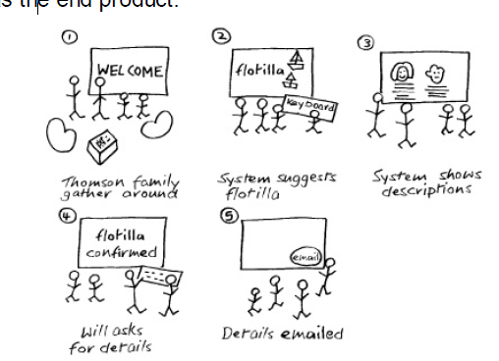
Generating Storyboards from Scenarios
We chose to draw a storyboard that focuses on the environment of the travel organizer, and it is shown in Figure. While drawing this, various questions relating to the environment came to mind such as how can the interaction be designed for all the family? Will they sit or stand? How confidential should the interaction be? What kind of documentation or help needs to be available? What physical components does the travel organizer need? And so on. In this exercise, the questions it prompts are just as important as the end product.

Slide 71
Generating Card-Based Prototypes from Use Cases
The value of a card-based prototype lies in the fact that the screens or interaction elements can be manipulated and moved around in order to simulate interaction with a user or to explore the user's end-to-end experience. Where a storyboard focusing on the screens has been developed, this can be translated into a card-based prototype and used in this way. Another way to produce a card-based prototype is to generate one from a use case output from the requirements activity.

Slide 72
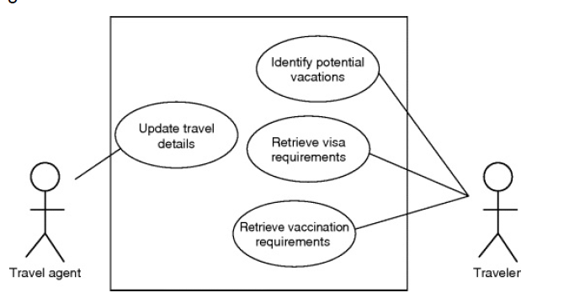
Generating Card-Based Prototypes from Use Cases
For example, consider the use case generated for the travel organizer which focused on the visa requirements part of the system.
For each step in the use case, the travel organizer will need to have an interactive component to deal with it, e.g. a button or menu option, or a display.
By stepping through the use case, it is possible to build up a card-based prototype to cover the required behavior.

Slide 73
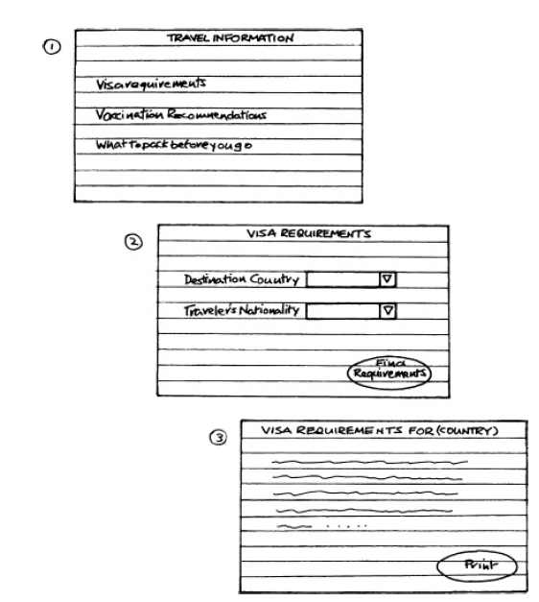
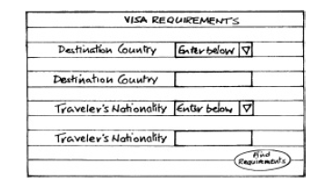
Generating Card-Based Prototypes from Use Cases
For example, the cards in Figure were developed by considering each of the steps in the use case.
Card one covers step 1;
card two covers steps 2, 3, 4, 5, 6, and 7;
and card three covers steps 8, 9, 10, and 11 (notice the print button that is drawn into card three to allow for steps 10 and 11).
As with the storyboards, drawing concrete elements of the interface like this forces the designer to think about detailed issues so that the user can interact with the prototype.
In card two you will see that I chose to use a drop-down menu for the country and nationality. This is to avoid mistakes. However, the flaw in this is that I may not catch all of the countries in my list, and so an alternative design could also be incorporated where the user can choose an ‘enter below’ option and then type in the country or nationality.

Slide 74
Usability Testing

Slide 75
Usability Testing
The usability of products has traditionally been tested in controlled laboratory settings. This approach emphasizes how usable a product is.
It has been most commonly used to evaluate desktop applications, such as websites, word processors, and search tools.
Doing usability testing in a laboratory, or a temporarily assigned controlled environment, enables evaluators to control what users do and to control environmental and social influences that might impact the users’ performance.
The goal is to test whether the product being developed is usable by the intended user population to achieve the tasks for which it was designed.

Slide 76
Usability Testing
Why Usability Test?
The goals of usability testing vary by study, but they usually include:
Identifying problems in the design of the product or service
Uncovering opportunities to improve
Learning about the target user’s behavior and preferences

Slide 77
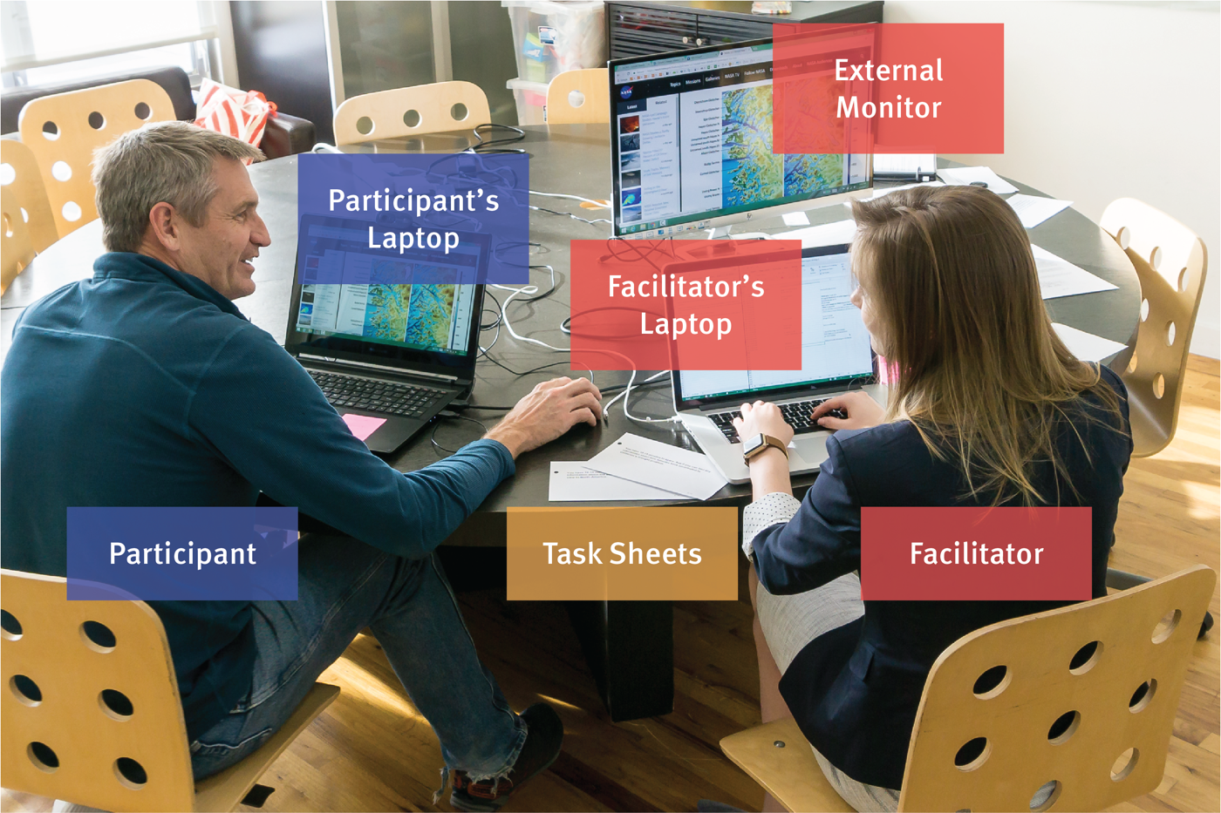
Usability Testing
Elements of Usability Testing
There are many different types of usability testing, but the core elements in most usability tests are the facilitator, the tasks, and the participant.

Slide 78
Usability Testing
Facilitator
The facilitator guides the participant through the test process. She gives instructions, answers the participant’s questions, and asks followup questions.
The facilitator works to ensure that the test results in high-quality, valid data, without accidentally influencing the participant’s behavior. Achieving this balance is difficult and requires training.
(In one form of remote usability testing, called remote unmoderated testing, an application may perform some of the facilitator’s roles.)

Slide 79
Usability Testing
Tasks
to narrate their actions and thoughts as they perform tasks. The goal of this approach is to understand participants’ behaviors, goals, thoughts, and motivations.
The tasks in a usability test are realistic activities that the participant might perform in real life. They can be very specific or very open-ended, depending on the research questions and the type of usability testing.
Examples of tasks from real usability studies:
Your printer is showing “Error 5200”. How can you get rid of the error message?
You're considering opening a new credit card with Wells Fargo. Please visit wellsfargo.com and decide which credit card you might want to open, if any.
You’ve been told you need to speak to Tyler Smith from the Project Management department. Use the intranet to find out where they are located. Tell the researcher your answer.
Task wording is very important in usability testing. Small errors in the phrasing of a task can cause the participant to misunderstand what they’re asked to do or can influence how participants perform the task (a psychological phenomenon called priming).
Task instructions can be delivered to the participant verbally (the facilitator might read them) or can be handed to a participant written on task sheets. We often ask participants to read the task instructions out loud. This helps ensure that the participant reads the instructions completely, and helps the researchers with their notetaking because they always know which task the user is performing.

Slide 80
Usability Testing
Participant
The participant should be a realistic use of the studied product or service. That might mean that the user is already using the product or service in real life. Alternatively, in some cases, the participant might just have a similar background to the target user group or might have the same needs, even if he isn’t already a user of the product.
Participants are often asked to think out loud during usability testing (called the “think-aloud method”). The facilitator might ask the participants

Slide 81
Usability Testing
Types of Usability Testing
Qualitative vs. Quantitative
Usability testing can be either qualitative or quantitative.
Qualitative usability testing focuses on collecting insights, findings, and anecdotes about how people use the product or service. Qualitative usability testing is best for discovering problems in the user experience. This form of usability testing is more common than quantitative usability testing.
Quantitative usability testing focuses on collecting metrics that describe the user experience. Two of the metrics most commonly collected in quantitative usability testing are task success and time on task. Quantitative usability testing is best for collecting benchmarks.
The number of participants needed for a usability test varies depending on the type of study. For a typical qualitative usability study of a single user group, we recommend using five participants to uncover the majority of the most common problems in the product.

Slide 82
Usability Testing
Remote vs. In-Person Testing
Remote usability tests are popular because they often require less time and money than in-person studies. There are two types of remote usability testing: moderated and unmoderated.
Remote moderated usability tests work very similarly to in-person studies. The facilitator still interacts with the participant and asks her to perform tasks. However, the facilitator and participant are in different physical locations. Usually, moderated tests can be performed using screen-sharing software like Skype or GoToMeeting.
Remote unmoderated remote usability tests do not have the same facilitator–participant interaction as an in-person or moderated tests. The researcher uses a dedicated online remote-testing tool to set up written tasks for the participant. Then, the participant completes those tasks alone on her own time. The testing tool delivers the task instructions and any followup questions. After the participant completes her test, the researcher receives a recording of the session, along with metrics like task success.

Slide 83
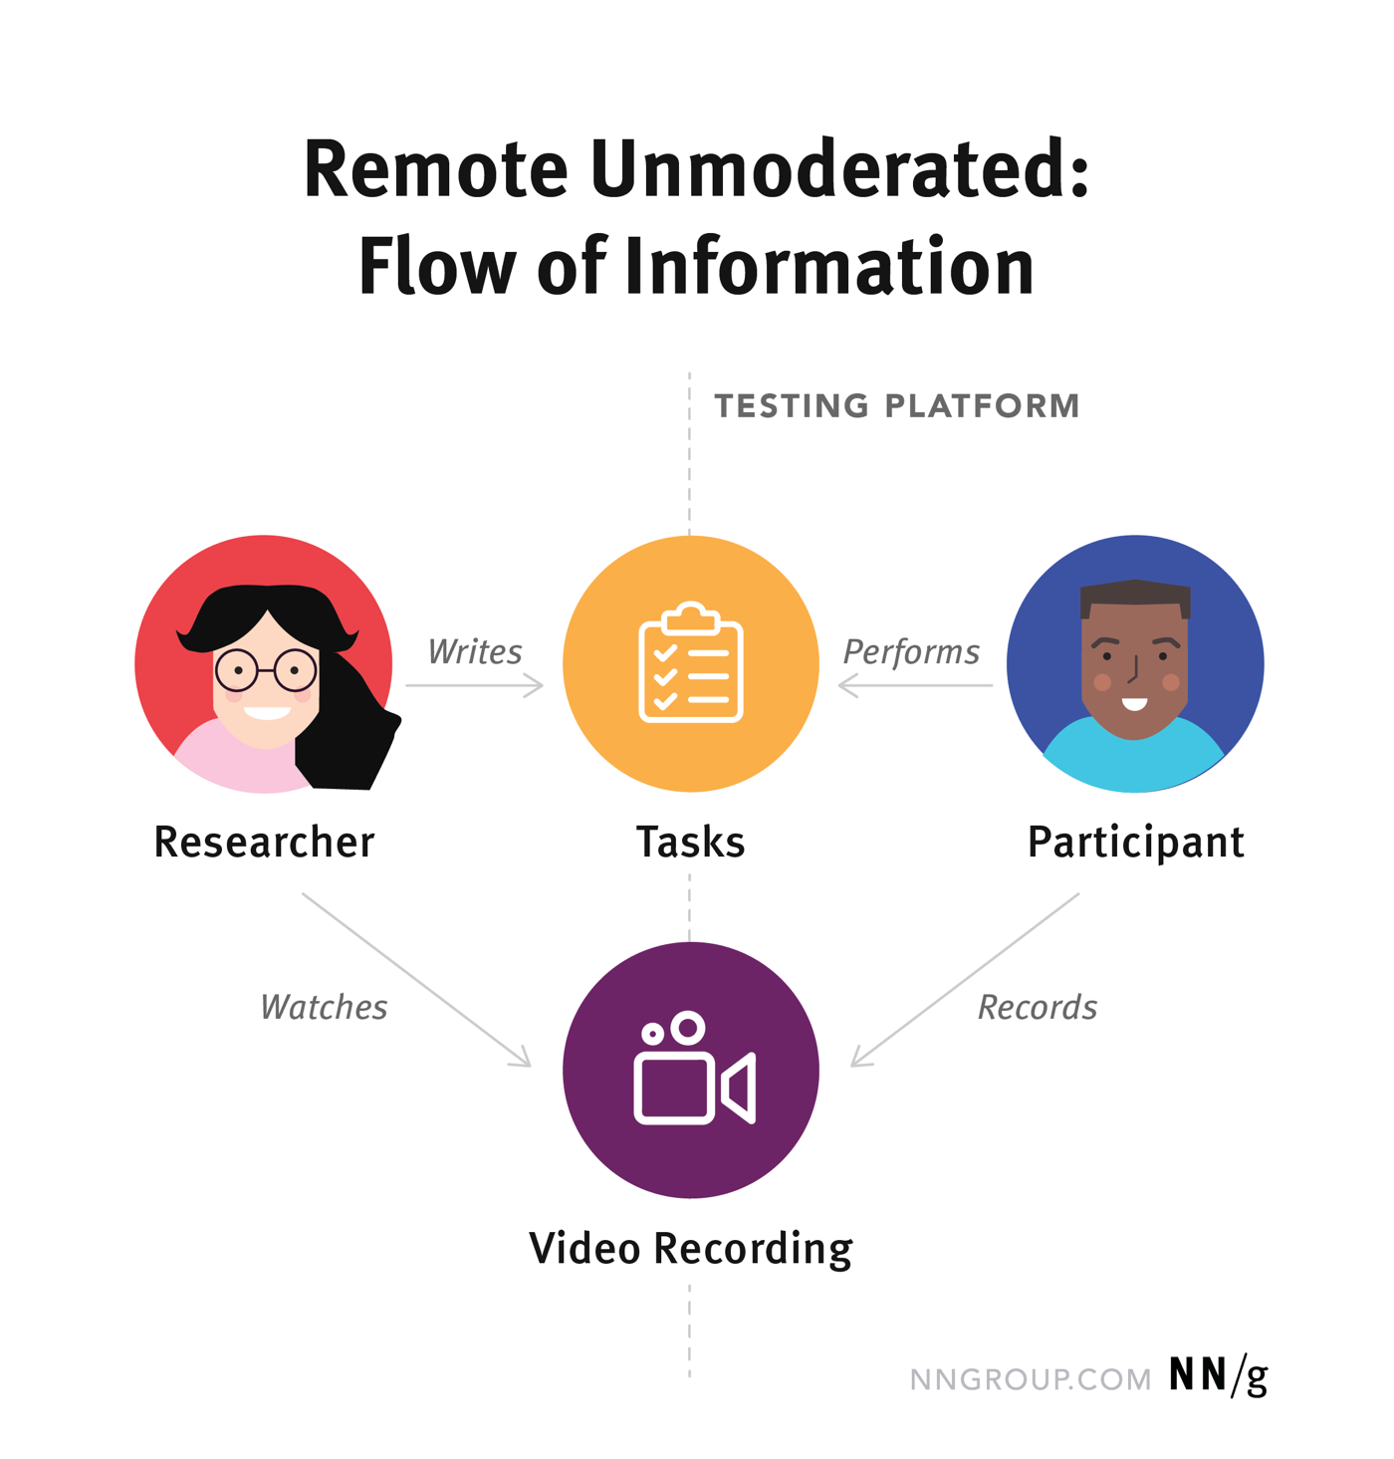
Usability Testing

Slide 84
Cost of Usability Testing
Simple, “discount” usability studies can be inexpensive, though you usually must pay a few hundred dollars as incentives to participants. The testing session can take place in a conference room, and the simplest study will take 3 days of your time (assuming that you have already learned how to do it, and you have access to participants):
Day 1: Plan the study
Day 2: Test the 5 users
Day 3: Analyze the findings and convert them into redesign recommendations for the next iteration
On the other hand, more-expensive research is sometimes required, and the cost can run into several hundred thousand dollars for the most elaborate studies.

Slide 85
Usability Testing
An Example of Usability Testing: The iPad
Usability specialists Budiu and Nielsen (2010) from the Nielsen Norman Group conducted a usability test of the websites and apps specific to the iPad.
They wanted to understand how the interactions with the device affected people and to get feedback to their clients and developers as well as those who were eager to know if the iPad lived up to the hype – which was being reported at the time it came to market.
They used two methods: usability testing with think-aloud in which users said what they were doing and thinking as they did it, and an expert review.
A key question they asked was: ‘Are user expectations different for the iPad compared with the iPhone?’. A previous study of the iPhone showed people preferred using apps than browsing the web because the latter was slow and cumbersome at that time. Would this be the same for the iPad, where the screen was larger and web pages were more similar to how they appeared on the laptops or desktop computers that most people were used to using?.
Budiu and Nielsen also hoped that their study would be able to address the question that many companies were considering at that time: whether it was worth developing specific websites for the iPad (in the way some companies were doing for smartphones) or would the desktop versions be acceptable when interacted with using the iPad multitouch interface.

Slide 86
Usability Testing
An Example of Usability Testing: The iPad
The usability testing was carried out in two cities in the United States: Fremont, California, and Chicago. The test sessions were similar; the aim of both was to understand the typical usability issues that people encounter when using applications and accessing websites on the iPad.
Seven participants were recruited: all were experienced iPhone users who had owned their phones for at least 3 months and who had used a variety of apps. One participant was also an iPad owner. One reason for selecting participants who used iPhones was because they would have previous experience of using apps and the web with a similar interaction style to the iPad.
The participants were considered typical users. They varied in age and occupation. Two participants were in their 20s, three were in their 30s, one was in their 50s, and one in their 60s. Their occupations were: food server, paralegal, medical assistant, retired food driver, account rep, and homemaker. Three were males and four were females.

Slide 87
Usability Testing
An Example of Usability Testing: The iPad
Before taking part, the participants were asked to read and sign an informed consent form agreeing to the terms and conditions of the study. This form described:
what the participant would be asked to do;
the length of time needed for the study;
the compensation that would be offered for participating;
the participants’ right to withdraw from the study at any time;
a promise that the person's identity would not be disclosed; and
an agreement that the data collected would be confidential and would not be made available to marketers or anyone other than the evaluators.

Slide 88
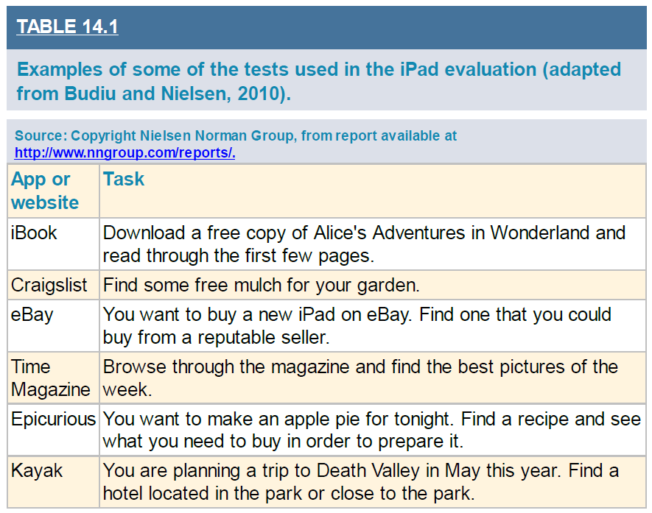
Usability Testing
An Example of Usability Testing: The iPad - The Tests
The session started with participants being invited to explore any application they found interesting on the iPad. They were asked to comment on what they were looking for or reading, what they liked and disliked about a site, and what made it easy or difficult to carry out a task.
A moderator sat next to each participant and observed and took notes. The sessions were video recorded and lasted about 90 minutes. Participants worked on their own.
After exploring the iPad they were asked by the evaluator to open specific apps or websites and to explore them, then carry out one or more tasks as they would if they were on their own.
Each was assigned the tasks in a randomized order. All the apps that were tested were designed specifically for the iPad, but for some tasks the users were asked to do the same task on a website that was not specifically designed for the iPad. For these tasks, the evaluators took care to balance the presentation order so that the app would be first for some participants and the website would be first for others. Over 60 tasks were chosen from over 32 different sites. Examples are shown in Table.

Slide 89
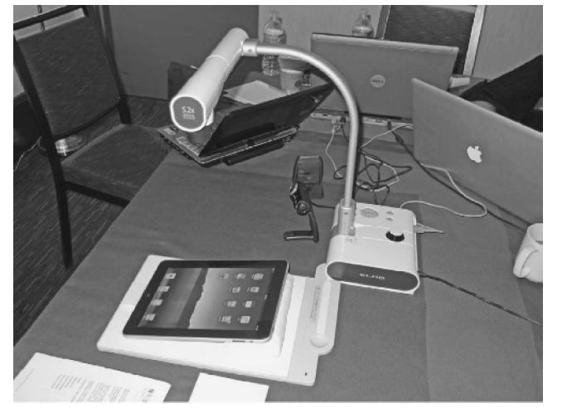
Usability Testing
An Example of Usability Testing: The iPad - The Equipment
The testing was done using a setup similar to the mobile usability kit shown in Figure.
A camera recorded the participant's interactions and gestures when using the iPad and streamed the recording to a laptop computer.
A webcam was also used to record the expressions on the participants’ faces and their think-aloud commentary. The laptop ran a software called Morae, which synchronized these two data streams. Up to three observers (including
the moderator sitting next to the participant) watched the video streams (rather than observing the participant directly) on their laptops situated on the table – meaning they did not have to invade the participants’ personal space.

Slide 90
Usability Testing
An Example of Usability Testing: The iPad - Usability Problems
The main findings from the study showed that the participants were able to interact with websites on the iPad but that it was not optimal. For example, links on the pages were often too small to tap on reliably and the fonts were sometimes difficult to read.
The various usability problems identified in the study were classified according to a number of well-known interaction design principles and concepts, including:
mental models,
navigation,
the quality of images,
problems with using a touch screen with small target areas,
lack of affordances,
getting lost in the application,
the effects of changing orientations,
working memory, and
the feedback that they received.

Slide 91
Usability Testing
An Example of Usability Testing: The iPad - Usability Problems
An example of a navigation problem identified during the evaluation was that when the cover of Time magazine appeared on the iPad, it didn't contain any hyperlinks. The contents page did but it was not easily accessible. In order to access it, users first had to tap the screen to reveal the controls at the bottom, then select the Contents button to display the contents carousel, and then select the contents page in the carousel.
Another problem they identified was that the participants sometimes did not know where to tap on the iPad to select options such as buttons and menus. It should be obvious from the affordances of an interface as to where they are and how to select them. However, the evaluators found that in many cases the participants repeatedly tapped the iPad interface in order to initiate an action, such as when trying to select an option from a menu.
Getting lost in an application is an old but important problem for designers of digital products and some participants got lost because they tapped the iPad too much and could not find a back button and could not get themselves back to the home page.
One participant said “ . . . I like having everything there [on the home page]. That's just how my brain works” (Budiu and Nielsen, 2010, p. 58).
Other problems arose because applications appeared differently in the two views possible on the iPad: portrait and landscape. More information was provided by some app developers in the horizontal (landscape) view than in the vertical (portrait) view, which caused problems for some participants.

Slide 92
Usability Testing
An Example of Usability Testing: The iPad - Interpreting and Presenting the Data
Based on the findings of their study, Budiu and Nielsen made a number of recommendations, including supporting standard navigation. The results of the study were written up as a report that was made publically available to app developers and the general public (it is available from www.nngroup.com).
It provided a summary of key findings for the general public as well as specific details of the problems the participants had with the iPad so that developers could decide whether to make specific websites and apps for the iPad.
While revealing how usable websites and apps are on the iPad, the usability testing was not able to reveal how they will be used in people’s everyday lives. This would require an in-the-wild study where observations are made of how people use them in their own homes and when traveling.

Slide 93
WIT and WIL Scenario

Slide 94
Practice Questions

Slide 95
References

Slide 96
THANK YOU

